Slide 1
#HeyBlue
Full project Overview

Slide 2
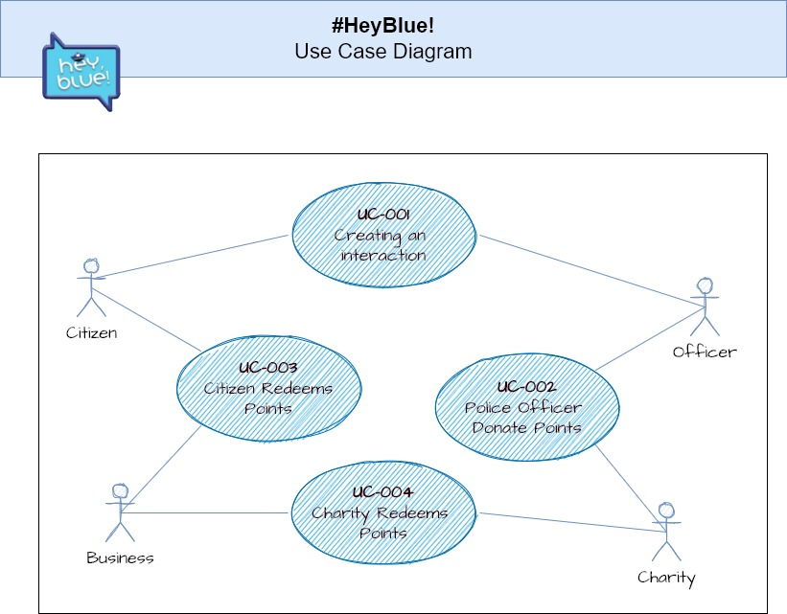
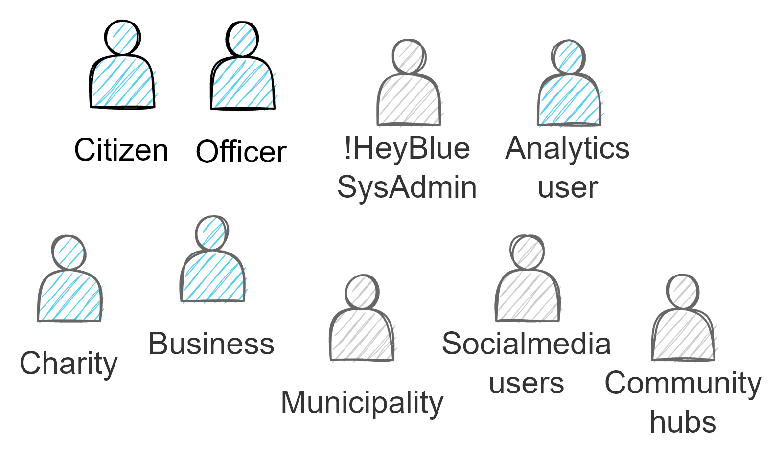
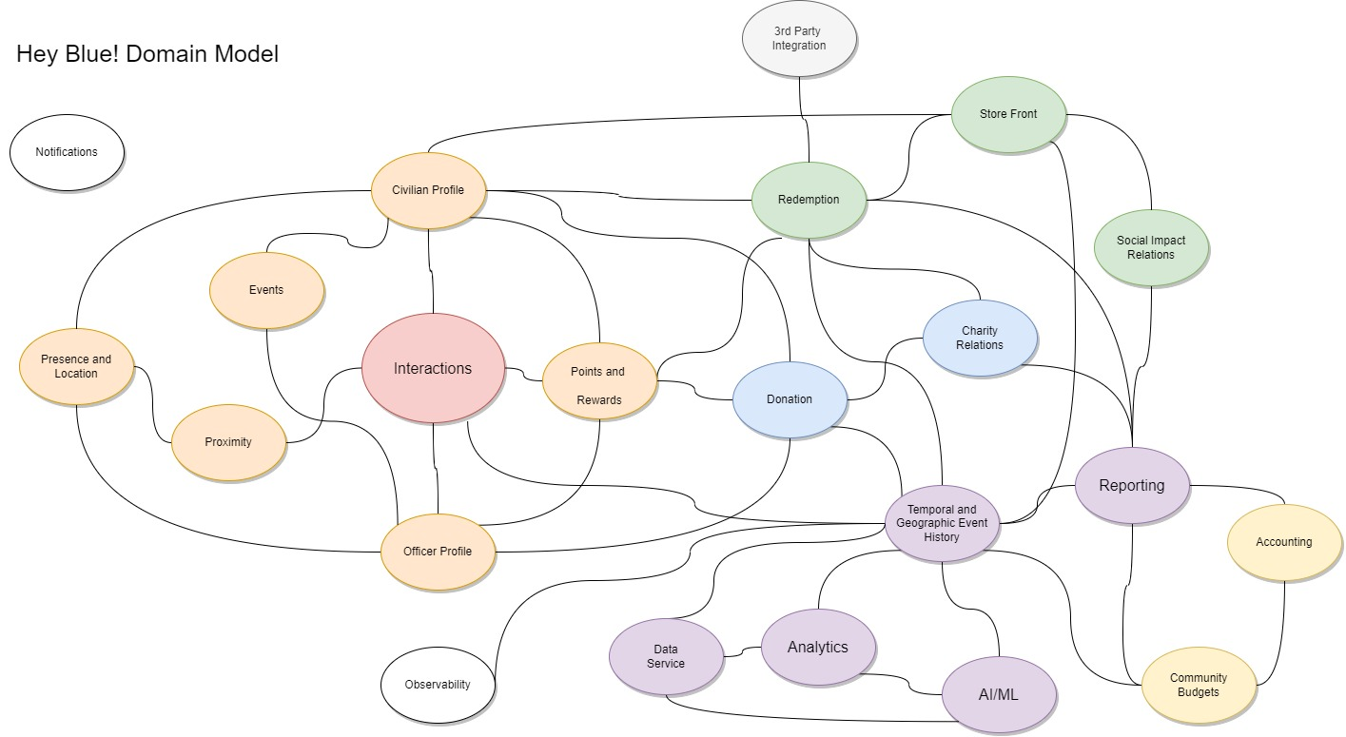
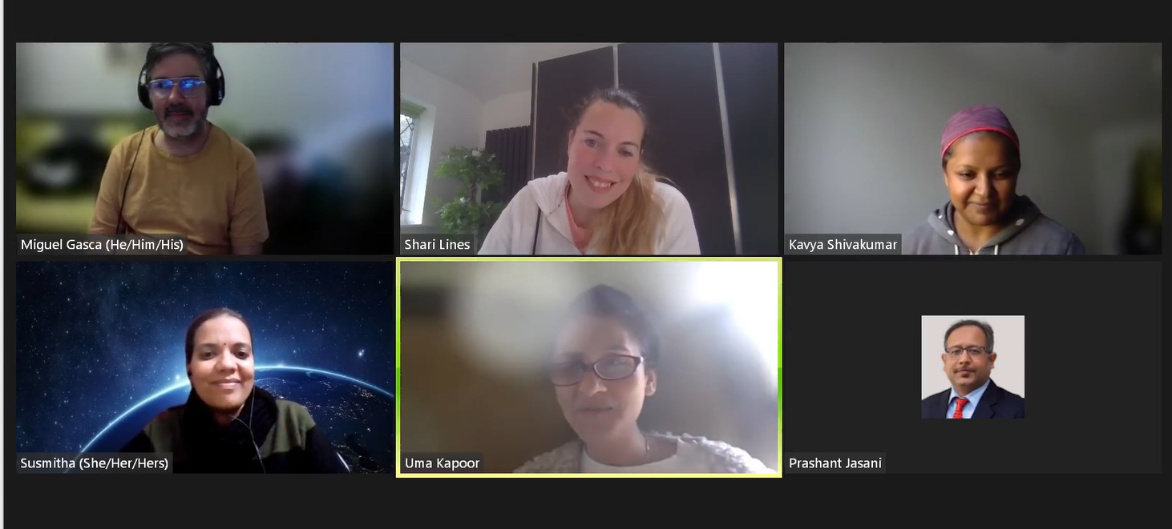
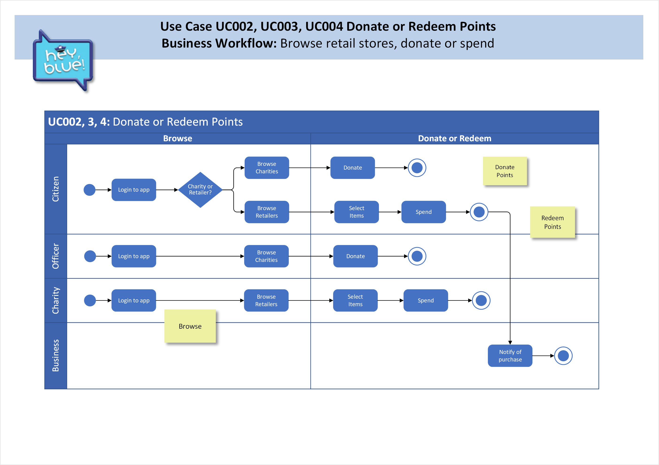
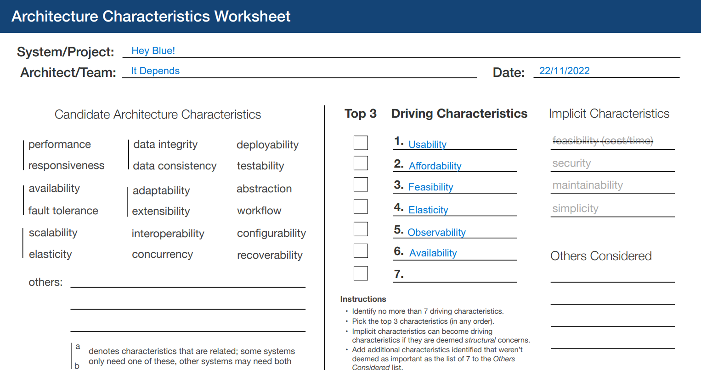
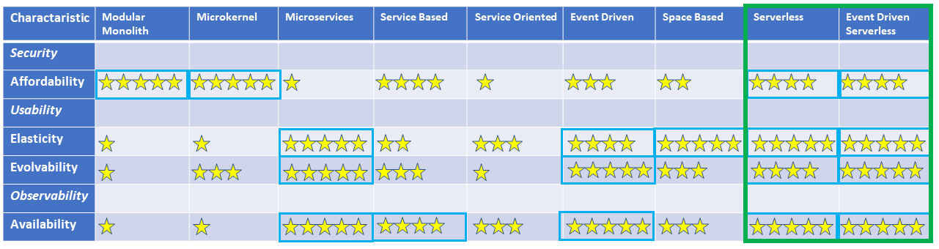
Where we started
Brainstorm
Establish
Skills, specialties
Working patterns
Commitment

Slide 3
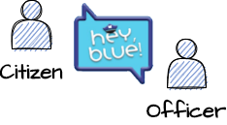
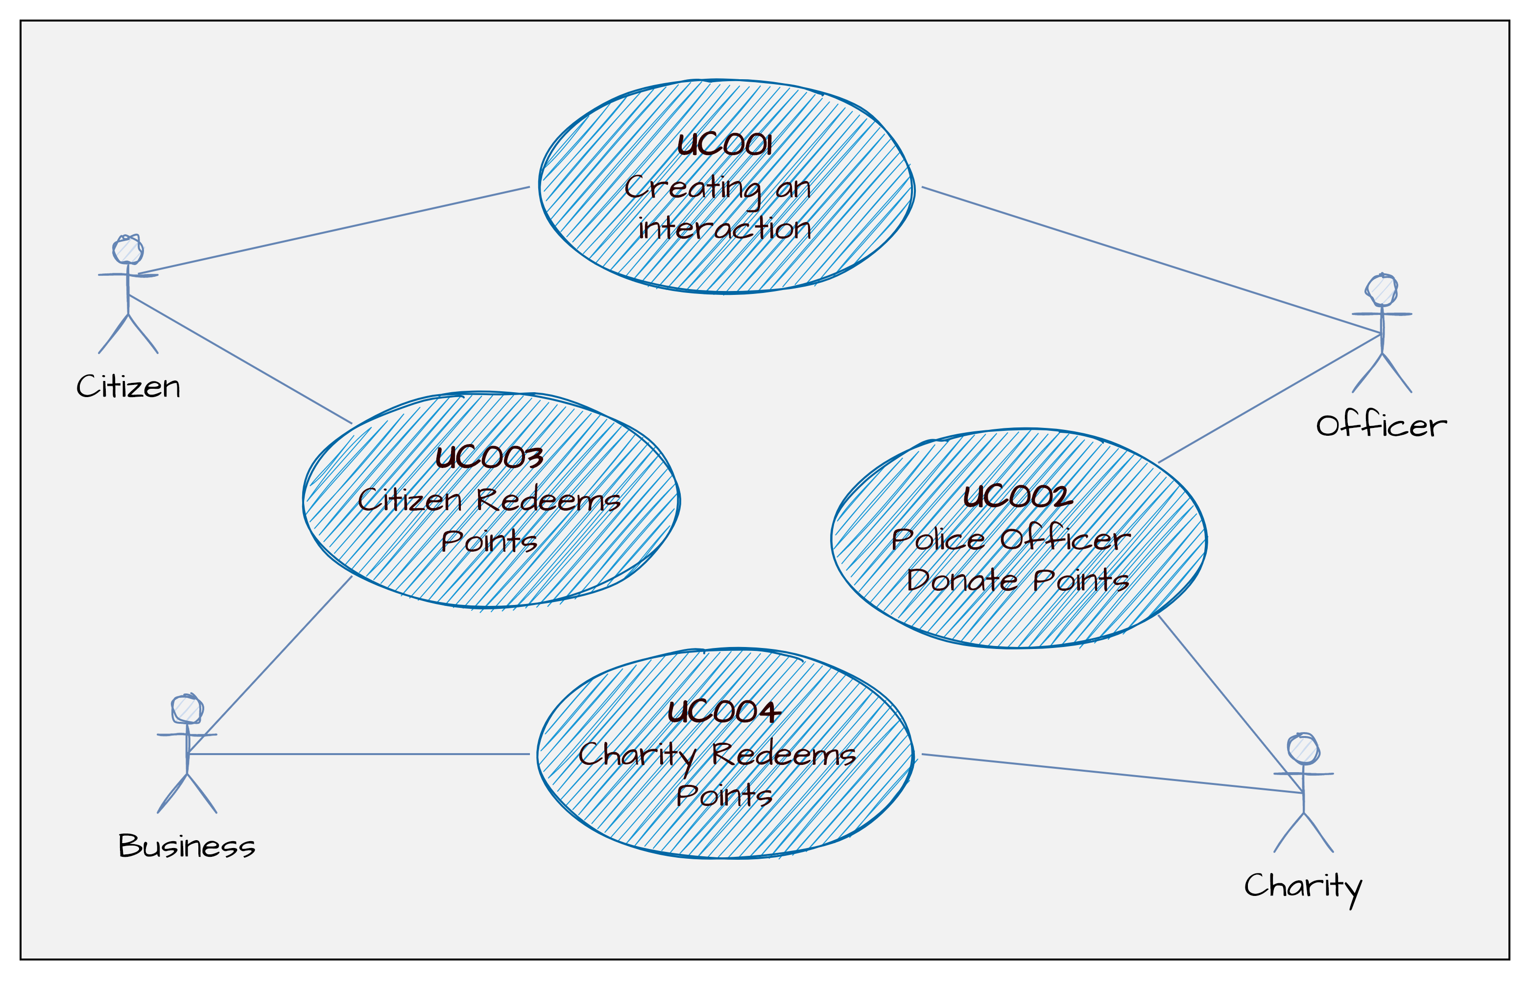

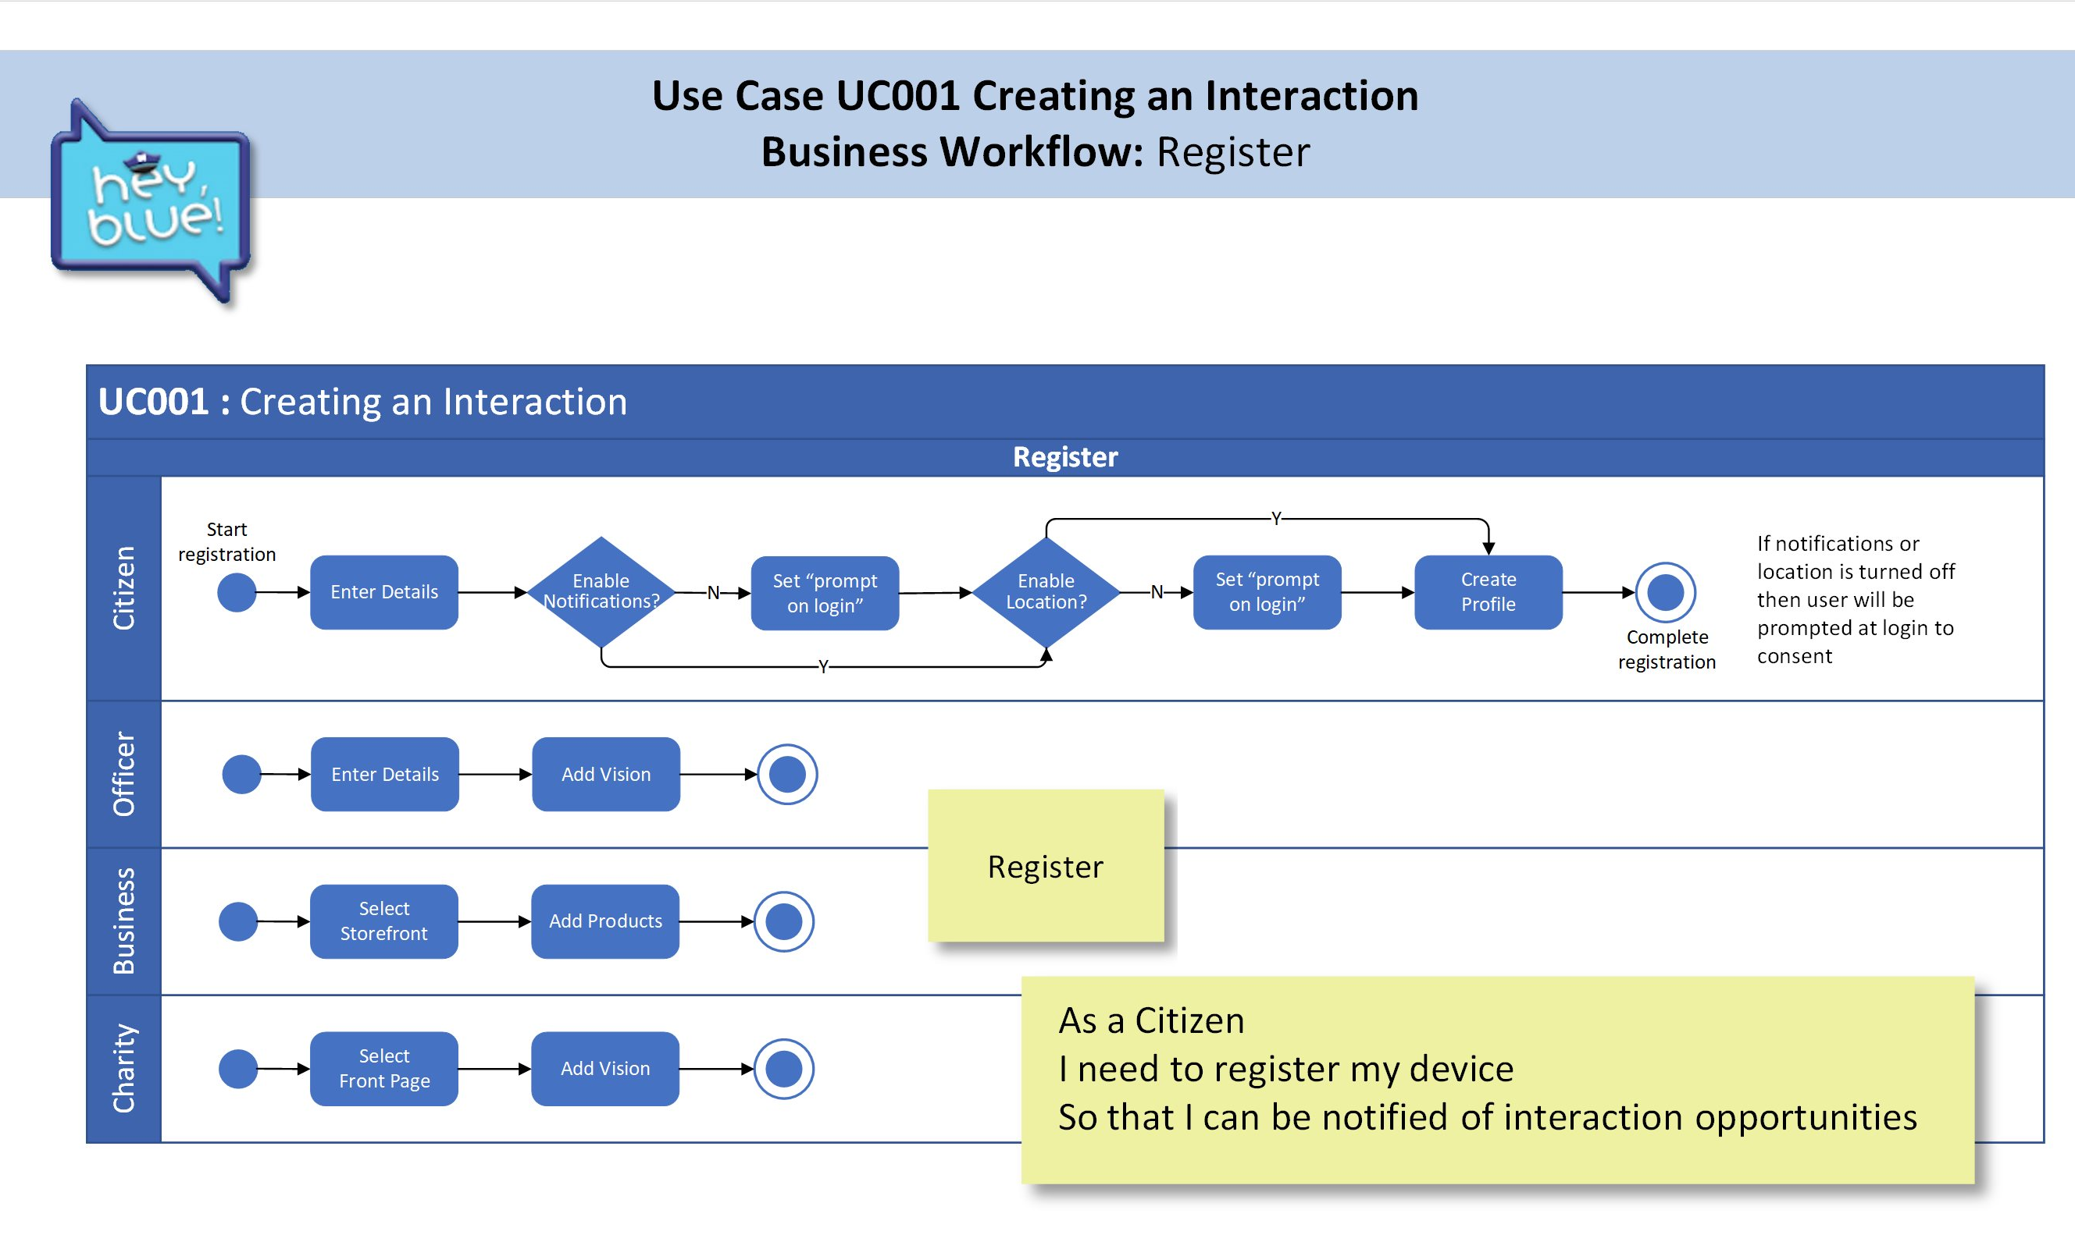

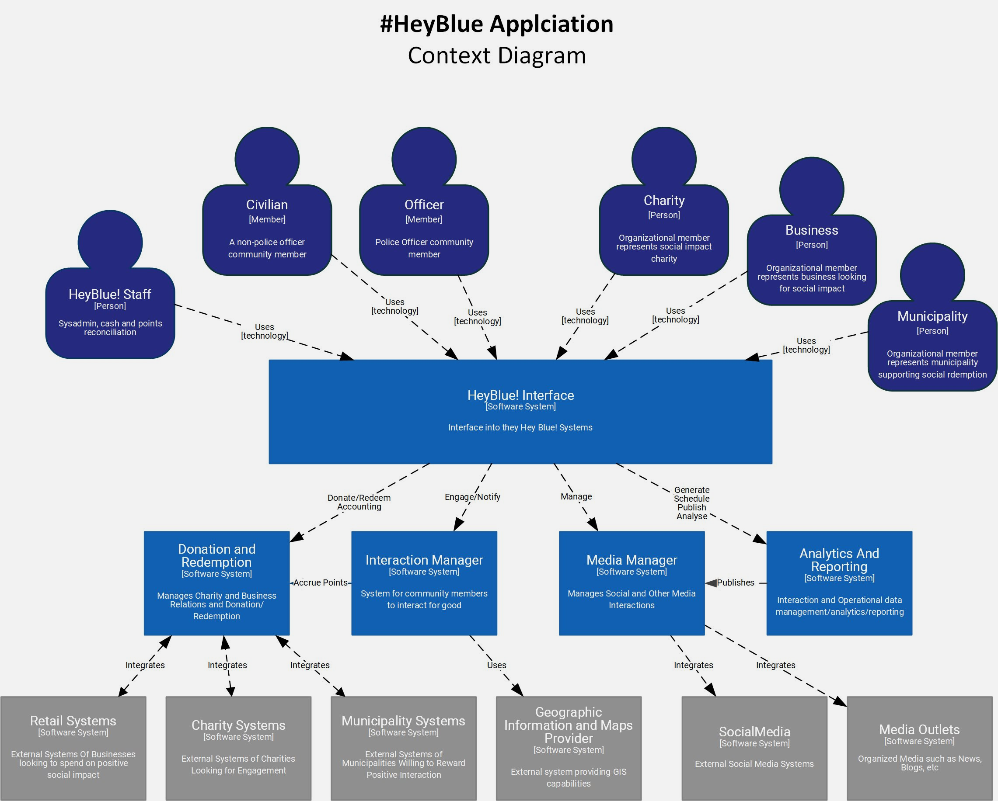
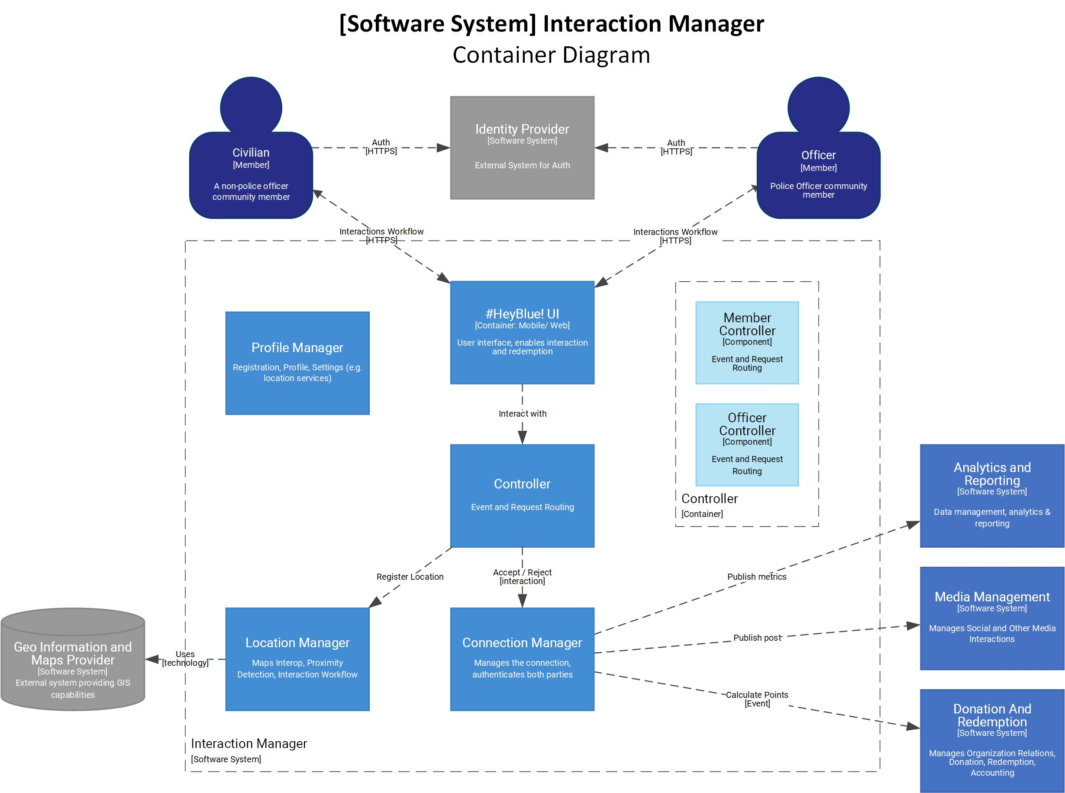
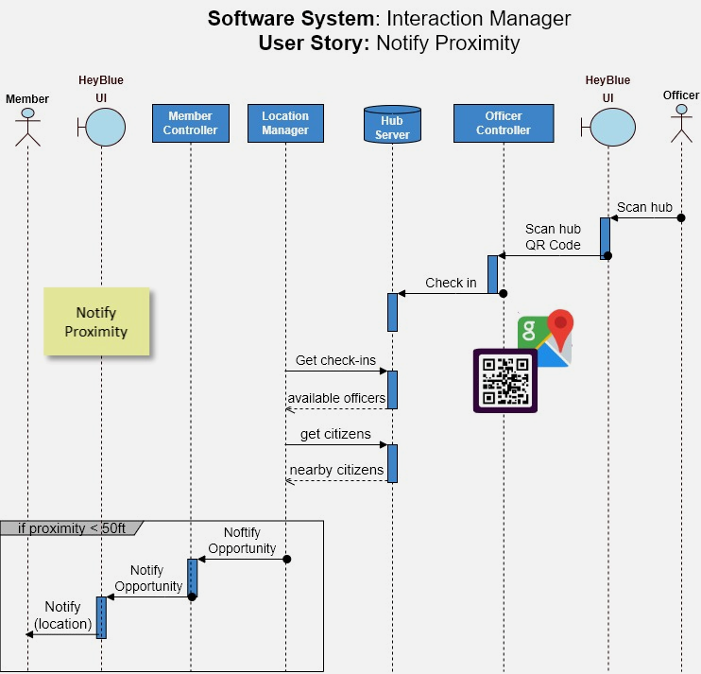
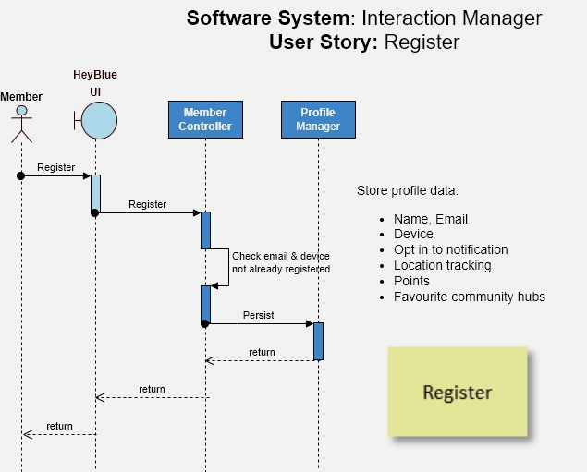
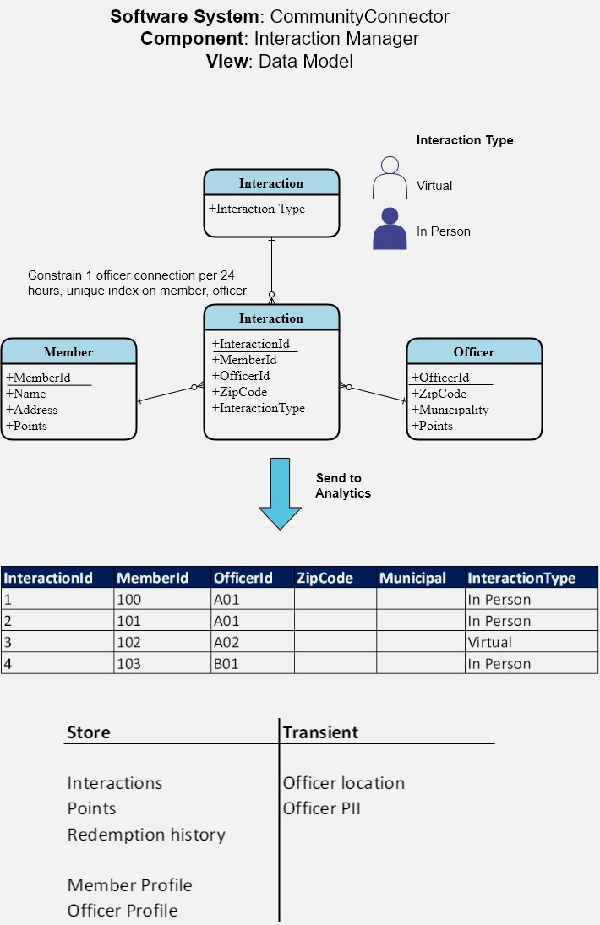
Connecting the dots
Our Approach:
Straight Through
Architecture

Slide 4

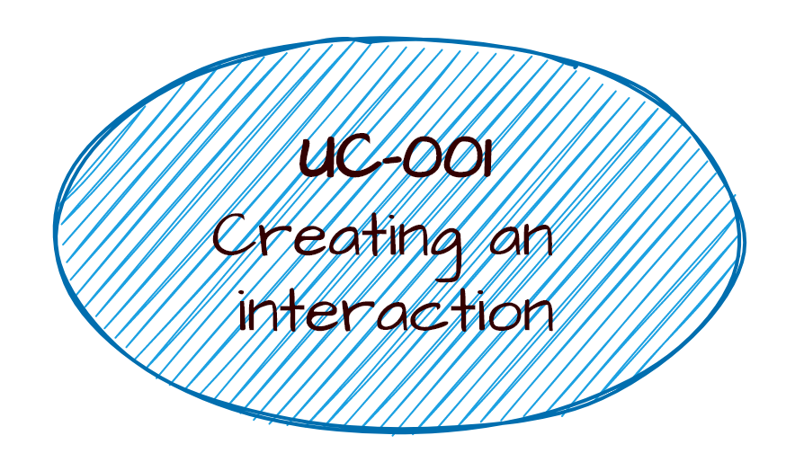

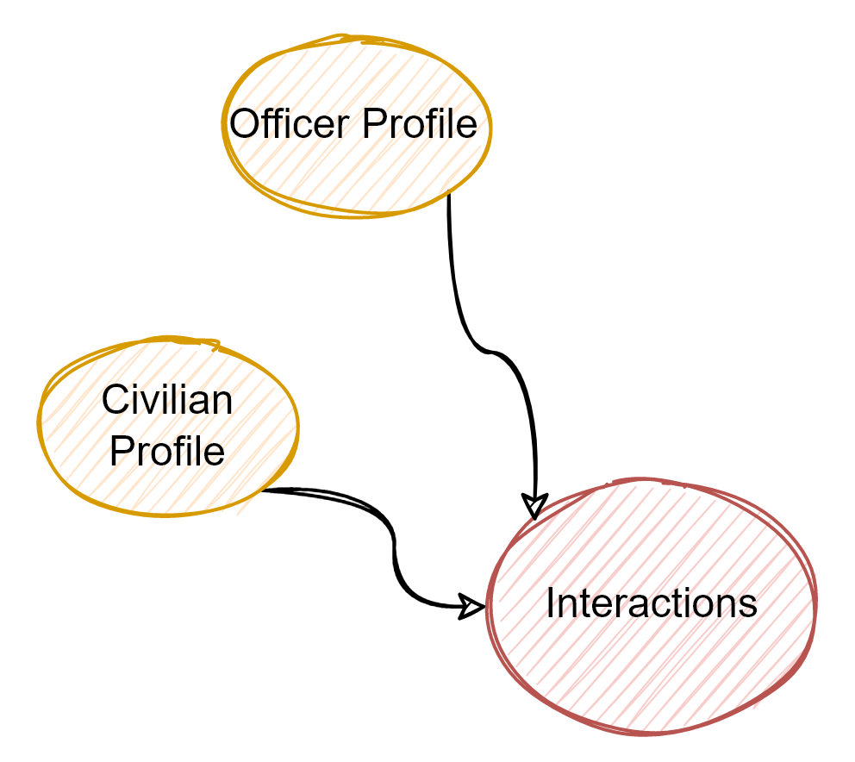
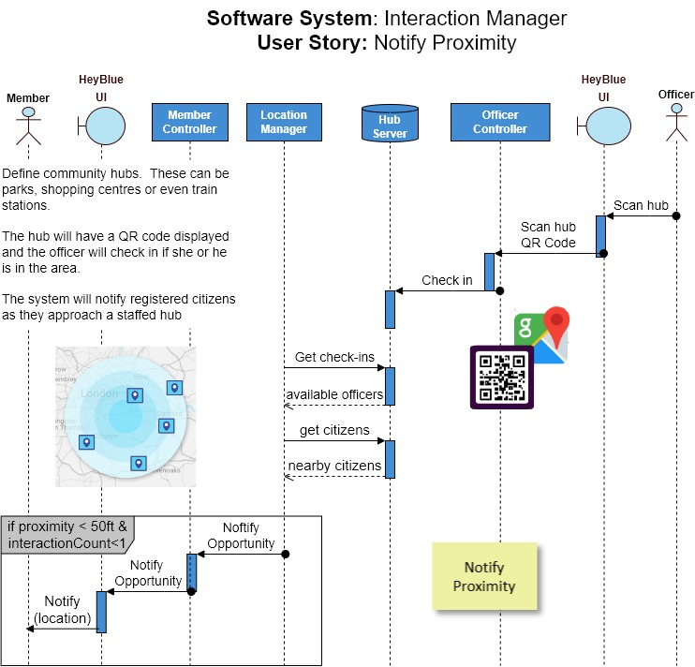
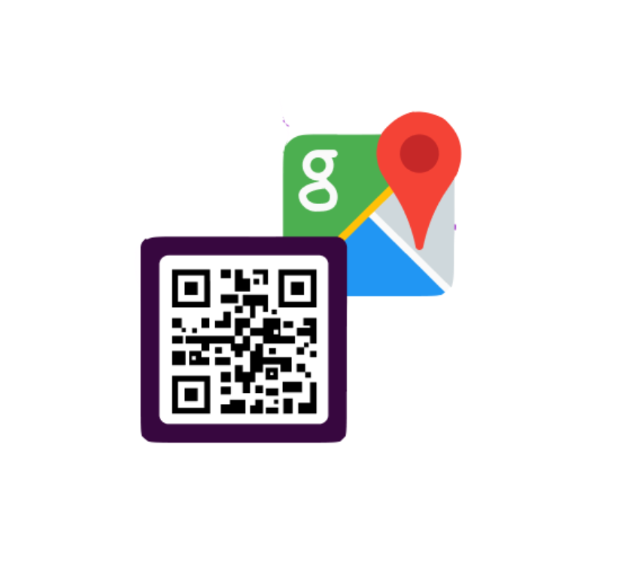
Connecting the dots
SR-009 Officers and Citizens must have the ability to connect with each other
US-001 As a user I need to be notified that an officer is available so that I can forge a community connection
ADR-009 Officer safety
SS-001 Interaction Manager Software System
ADR-012 Adopt MVVM
ADR-013 Protect officer location
ED-002 Interaction Manager Engineering Diagrams
SR-009
Officers and Citizens must have the ability to connect with each other
US-001
Register
User
US-002
Notify
Proximity
ADR-003 Architecture Characteristic Security
officer safety
zero trust
Interaction Manager
non functional
ADR-016 Data Protection, delete functionality
functional
Profile Manager
User
Controller
Connection Manager
#HeyBlue! UI
Location Manager
ADR-013 Design to protect officer location

Slide 5
Deviants
We decided to significantly deviate from the face-value requirements
We believe an architect has the responsibility to present alternatives
Instead of a system which tracks officer location (clear security risk!) we have introduced the concept of community hubs with QR Codes. When a meet and greet opportunity arises, citizens will be notified.

Slide 6
#HeyBlue! Requirements User Story Map
Interaction
Media
Donate & Redeem
Analytics & Reporting
US-001
Register
User
US-002
Notify
Proximity
US-003
Interact
US-004 Earn Points
US-005
Share
US-006
Register
3rd Party
US-007
Browse store
US-008
Redeem Points
US-009
Browse Charities
US-010
Donate
Points
US-011
Send to analytics
Create profile for Citizen
Location Tracking
Proximity Alert
Calculate Rewards
Share to #HeyBlue feed
Business storefront
Retailer creates storefront
Spend Manager
Charity Registers
Send to charity
Store metrics
Create profile for Officer
Officer location shutoff
Option to connect
Add rewards to profile
Share to Social Media
Charity front page
Store location alerts
Update points
Present metrics
Update profile
Get Map
Manage catalog
Purchase Items
Delete profile
Legend
Activity Group
User Stories
Task
Must have

Slide 7




#HeyBlue! Requirements User Story Map
Interaction
Media
Donate & Redeem
Analytics & Reporting
US-001
Register
User
US-002
Notify
Proximity
US-003
Interact
US-004 Earn Points
US-005
Share
US-006
Register
3rd Party
US-007
Browse store
US-008
Redeem Points
US-009
Browse Charities
US-010
Donate
Points
US-011
Send to analytics
Create profile for Citizen
Location Tracking
Proximity Alert
Calculate Rewards
Share to #HeyBlue feed
Business storefront
Retailer creates storefront
Spend Manager
Charity Registers
Send to charity
Store metrics
Create profile for Officer
Officer location shutoff
Option to connect
Add rewards to profile
Share to Social Media
Charity front page
Store location alerts
Update points
Present metrics
Update profile
Get Map
Manage catalog
Purchase Items
Delete profile
Legend
Activity Group
User Stories
Task
Must have

Slide 8
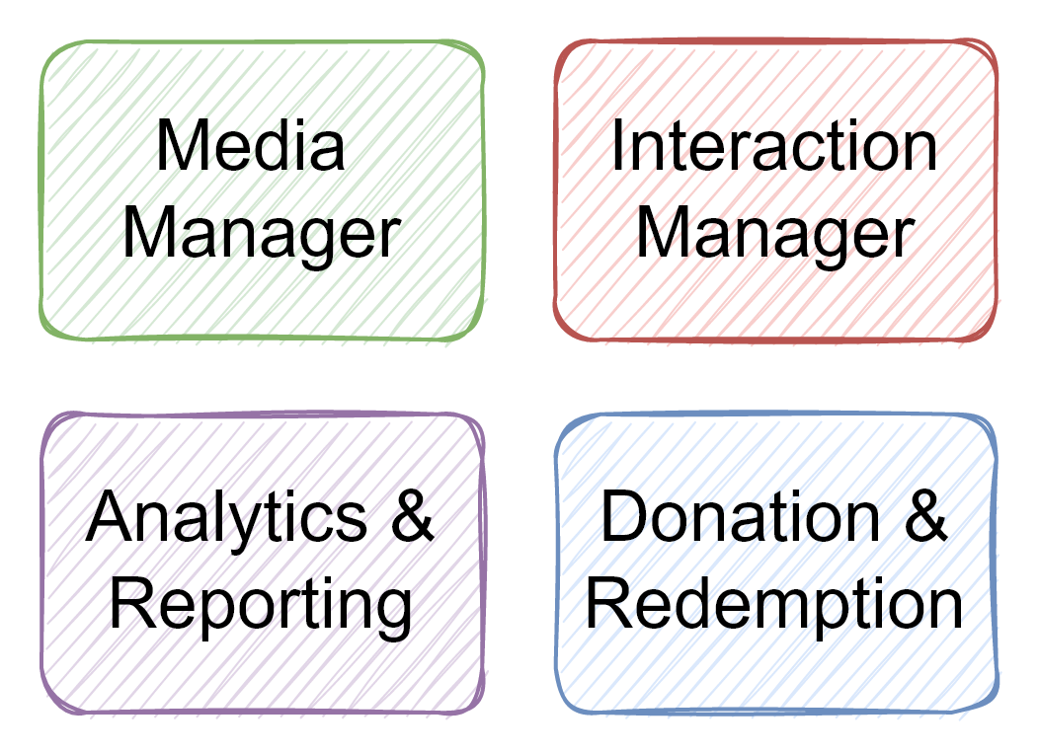
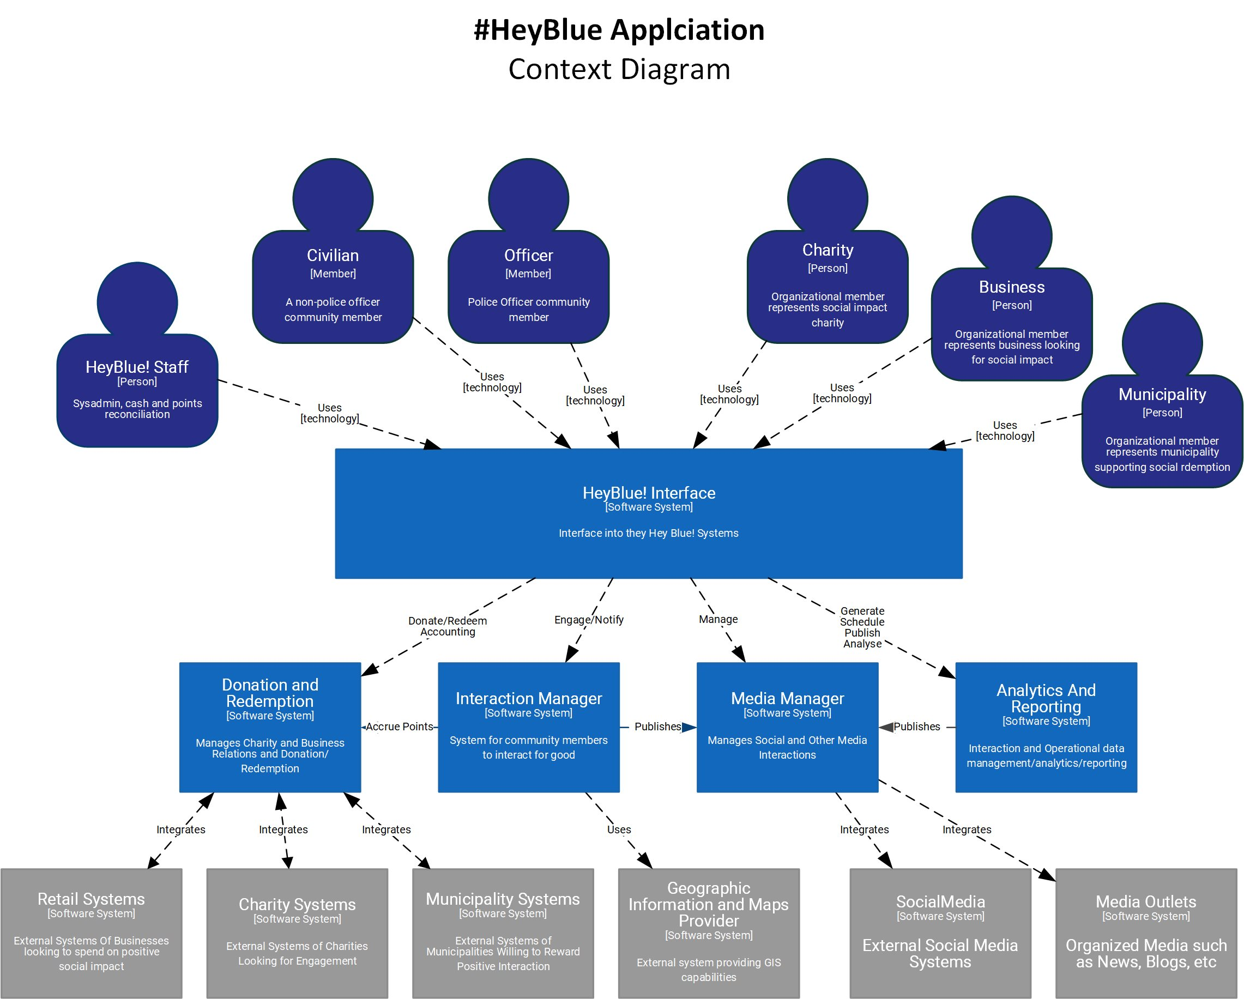
#HeyBlue! Solution
Context Diagram

Slide 9
#HeyBlue! Solution → Interaction Manager Software System Container Diagram

Slide 10
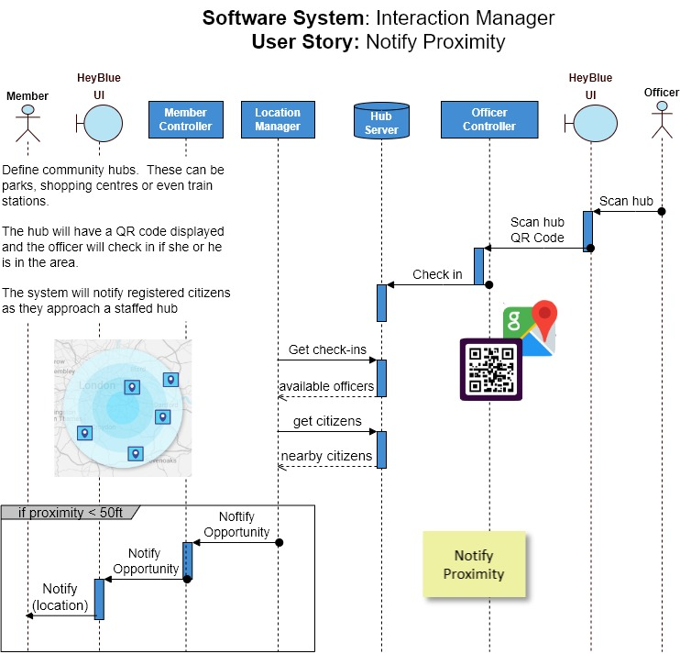
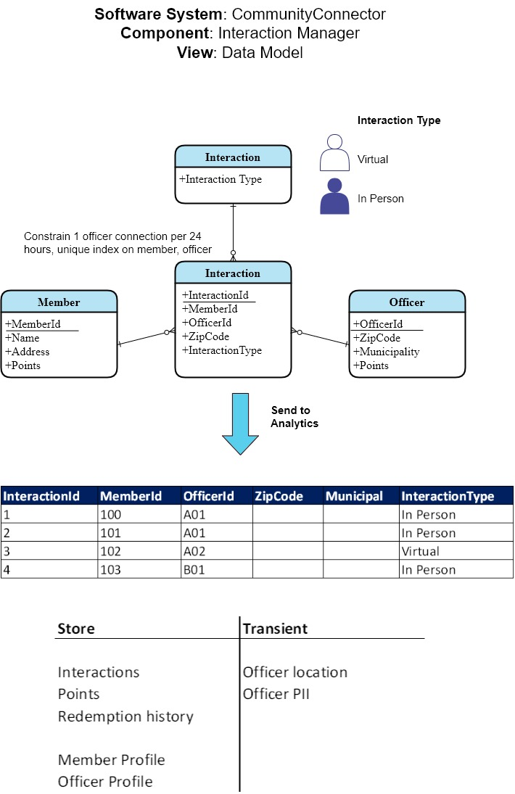
#HeyBlue! Solution → Interaction Manager Detailed Design and
Architecture Decision Record(s)

Slide 11
Lessons learned
Listen
Global
Checklist
Does every diagram have a legend and a title?
Have the requirements been met?
Will the architecture characteristics stand the test of time?
Does each artifact have a readme?
Are there any implicit decisions with unintended consequences?

